Slide 1
Agentic RAG

Slide 2
Topics
Generative AI
Large Language Models (LLMs)
Retrieval Augmented Generation (RAG)
Agentic AI
Multi-Agentic AI

Slide 3
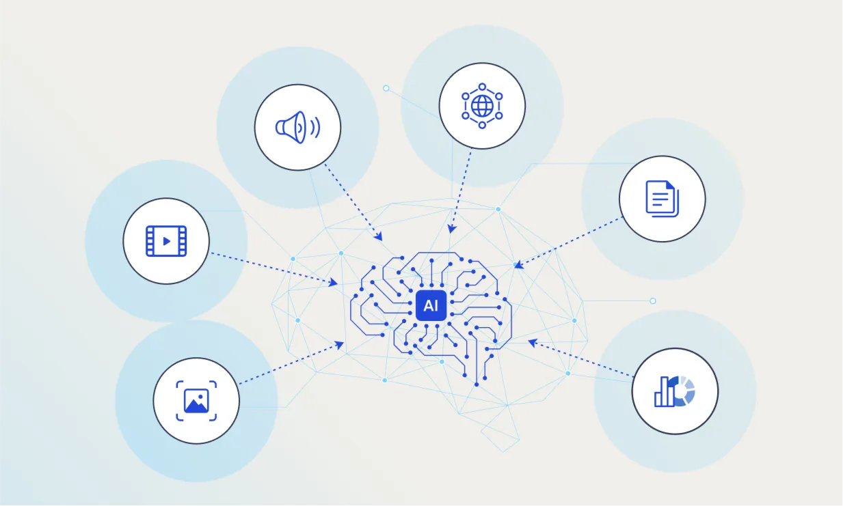
Generative AI
Generate new contents
Multimodal (text, images, codes, audio)

Slide 4

Large Language Models
Trained on vast text (documents, articles, books, etc.)
Language structure; grammar, syntax
Predict next word or phrase in sentence
Answering questions, writing essays, summarization, translation
Generative AI; generate text response

Slide 5

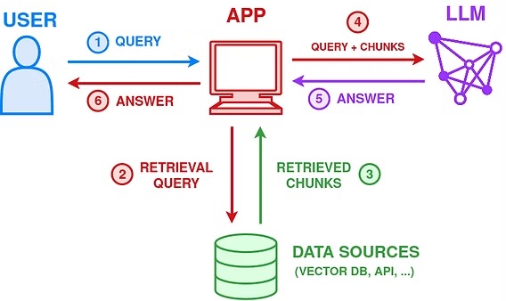
Retrieval Augmented Generation (RAG)
LLMs trained on static data
Knowledge cutoff
ChatGPT
RAG
Dynamic Knowledge Retrieval
Access to external data
Boost factuality

Slide 6

Agentic AI
Query vs. Objectives
Reactive vs. Proactive
Autonomy
Pursue big objectives/goals instead of per query-basis
Plan, make decisions
Execution loops

Slide 7
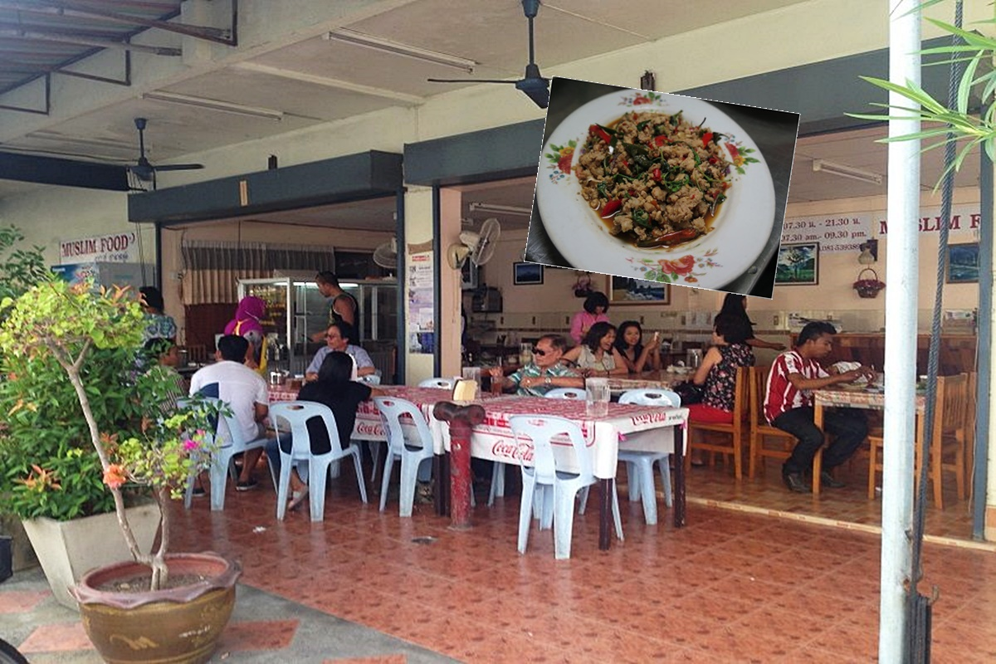
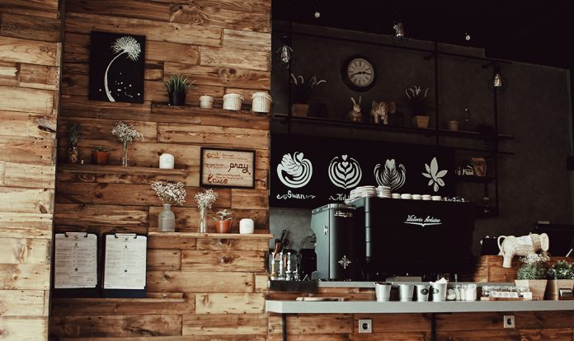
Multi-Agents
Compartmentalizing agents
General vs. Specialized

Slide 8

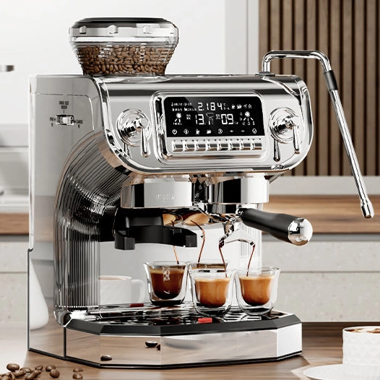
Agents as Tools

Slide 9
Recap
Generative AI
Large Language Models (LLMs)
Retrieval Augmented Generation (RAG)
Agentic AI
Multi-Agentic AI

Slide 10

Example: Medication Information Retrieval Chatbot
Patient prompt query or symptoms in natural language
AI responds with drug suggestions and example cases for doctor suggestions

Slide 11
RAG

Slide 12
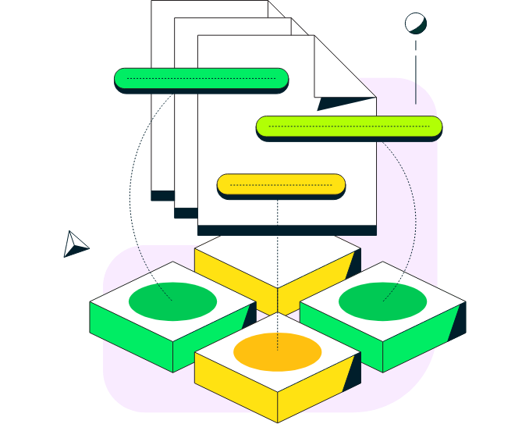
Retrieval
Reference/Contextual Datasets
Data Storage and Retrieval
Semantic Vector Search

Slide 13
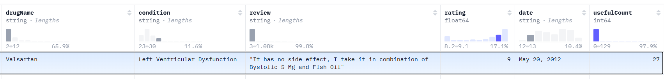
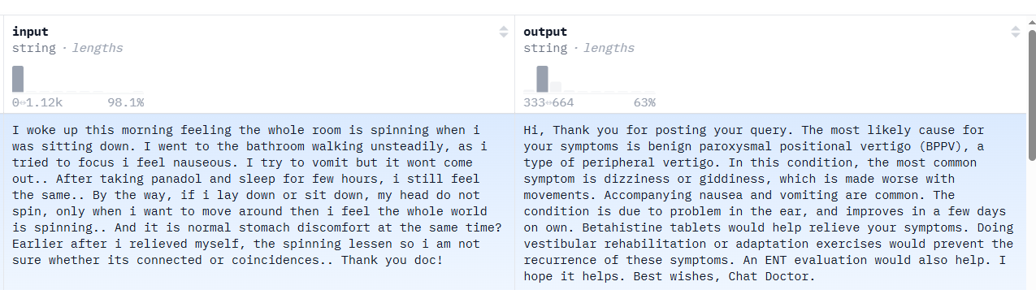
Reference/Contextual Data
Datasets from Hugging Face
Drug Reviews
Drug Name
Use Case
Review
1,000 data
Healthcare Conversation
Patient's symptoms
Doctor's suggestions
1,000 data

Slide 14

Data Storage and Retrieval
MongoDB Atlas
Storage
Retrieval
Full Text Search
Vector Search
Embeddings
Semantics
Hybrid Search
Rank
Weighting

Slide 15

Semantic Search
VoyageAI
Vector Embedding
Drug Reviews + Conversations

Slide 16
Agents

Slide 17



Multi-Agents
Orchestrator Agent
Medication Agent
Drug Reviews
Prompt / Display
Synthesizer Agent
Conversation History Agent
Conversation History

Slide 18
Chat System

Slide 19

Chat System
Store conversation on MongoDB Atlas
Re-feed whole conversation back as part of the query for extra contextual data for AI agents

Slide 20
What we’ll need
Google Colab
MongoDB Atlas
VoyageAI
OpenAI

Slide 21
https://colab.research.google.com/drive/
1jiS7i_hb28mPlHduK-NPnQwJSql6HbCm?usp=sharing

Slide 22
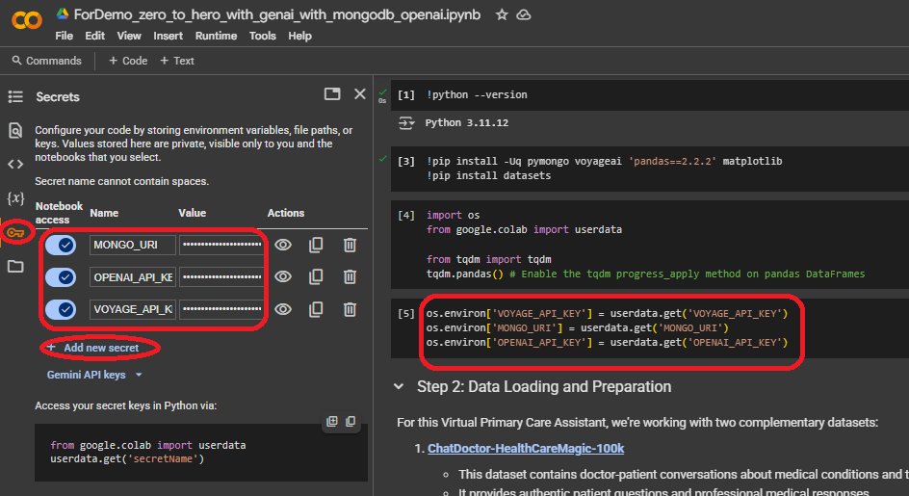

Slide 23
Setting Up MongoDB Atlas

Slide 24
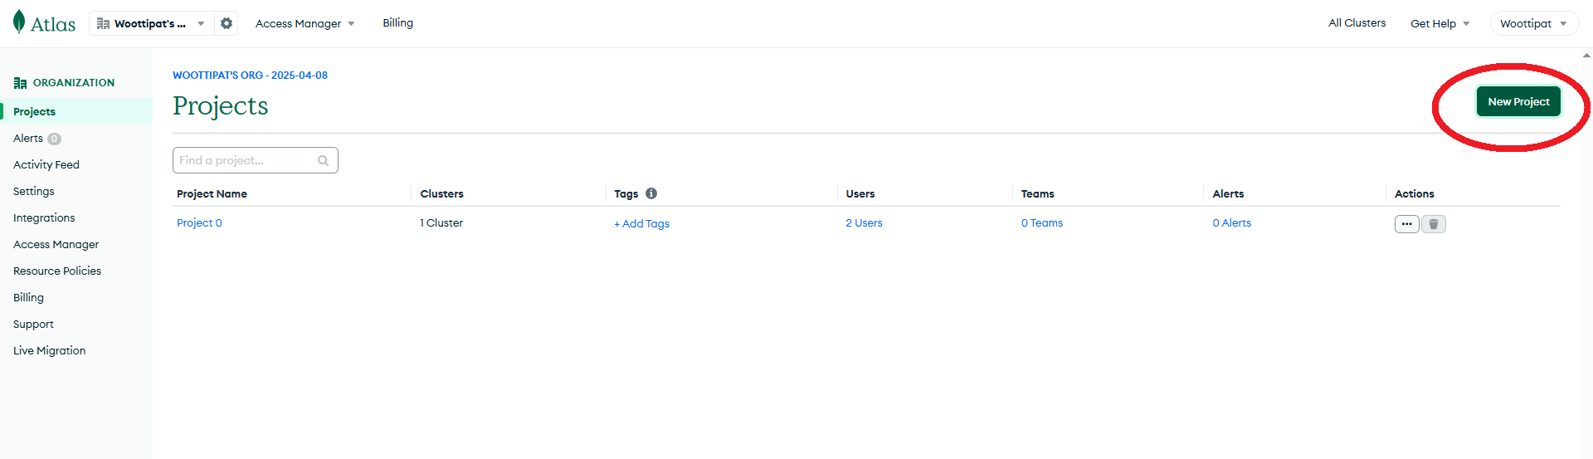

Slide 25
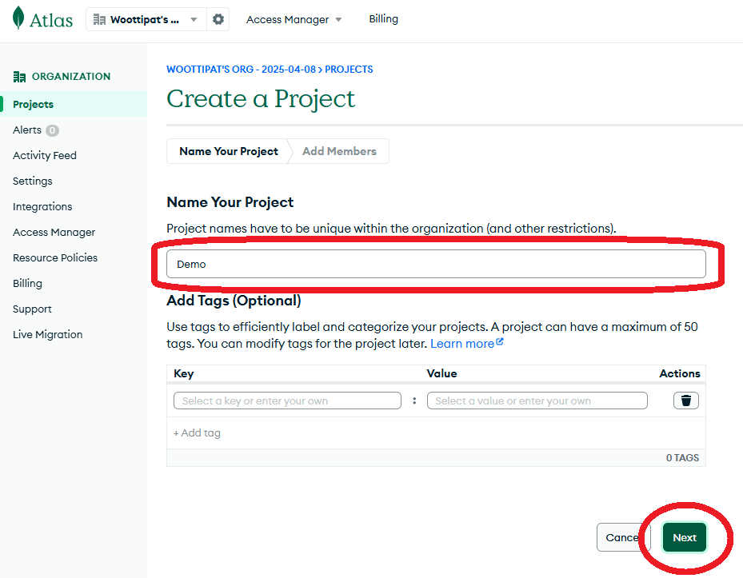

Slide 26
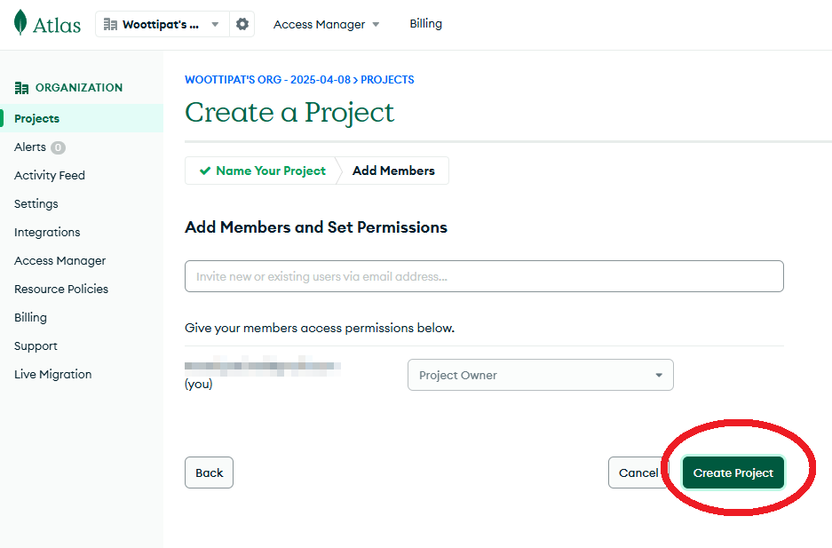

Slide 27
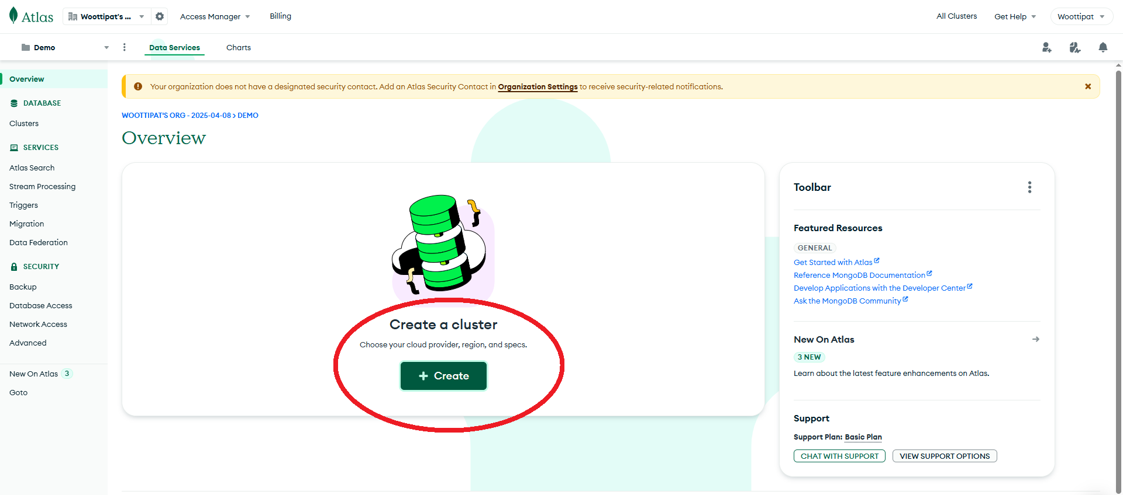

Slide 28
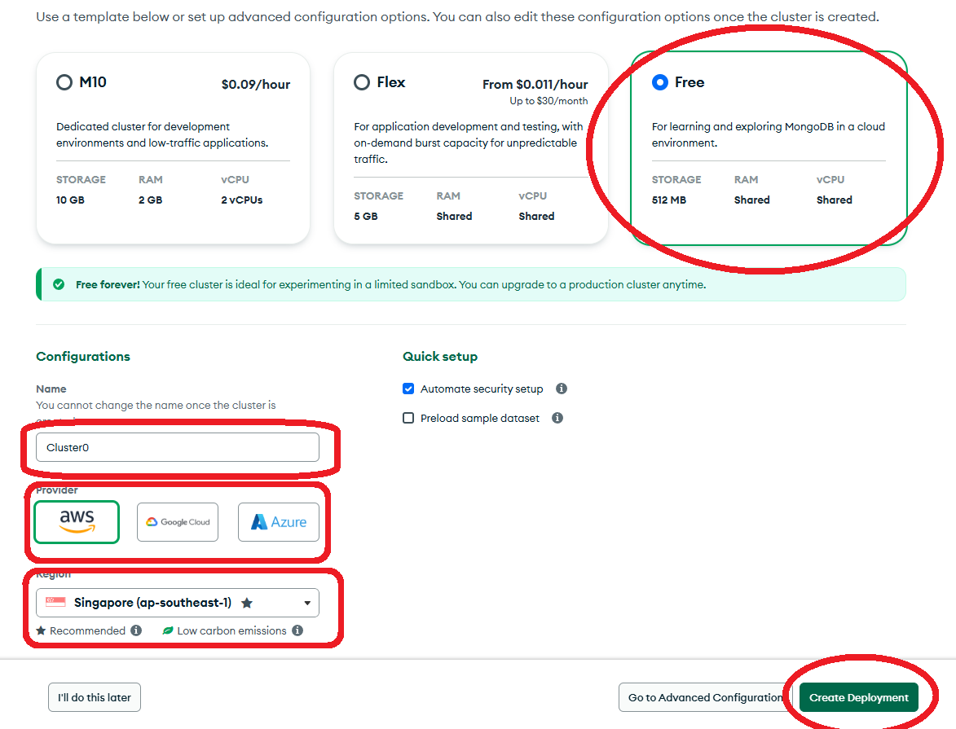

Slide 29
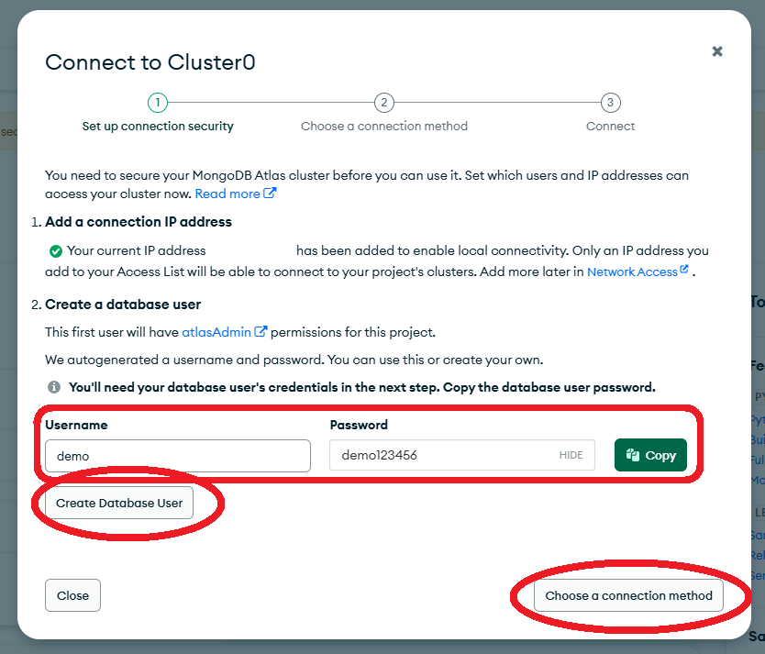

Slide 30
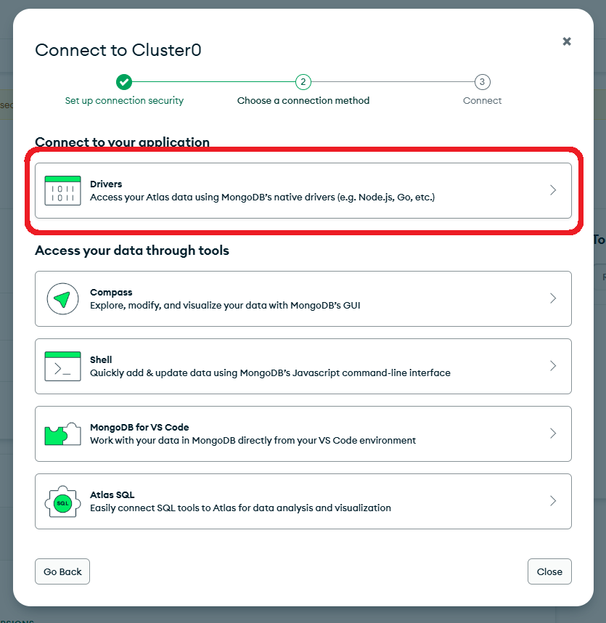

Slide 31
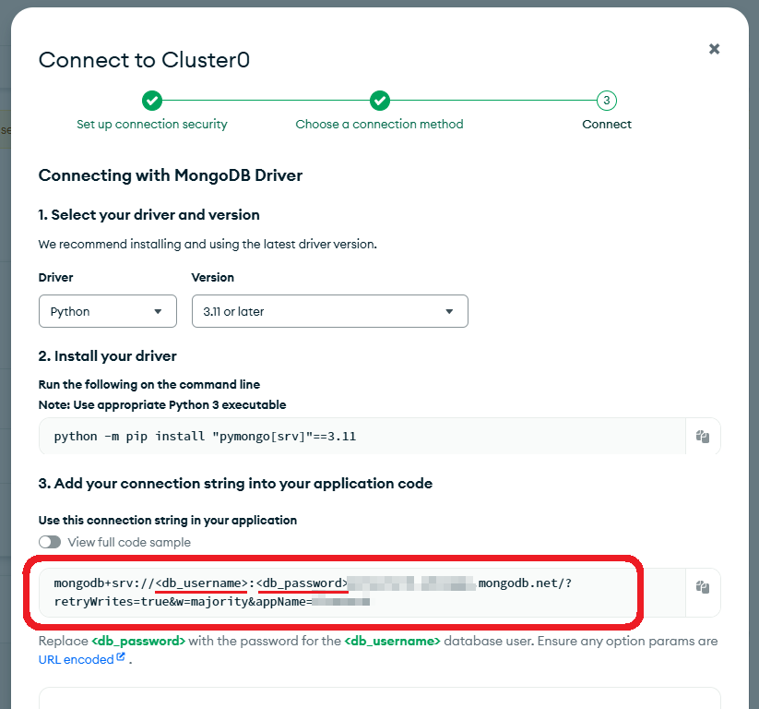

Slide 32
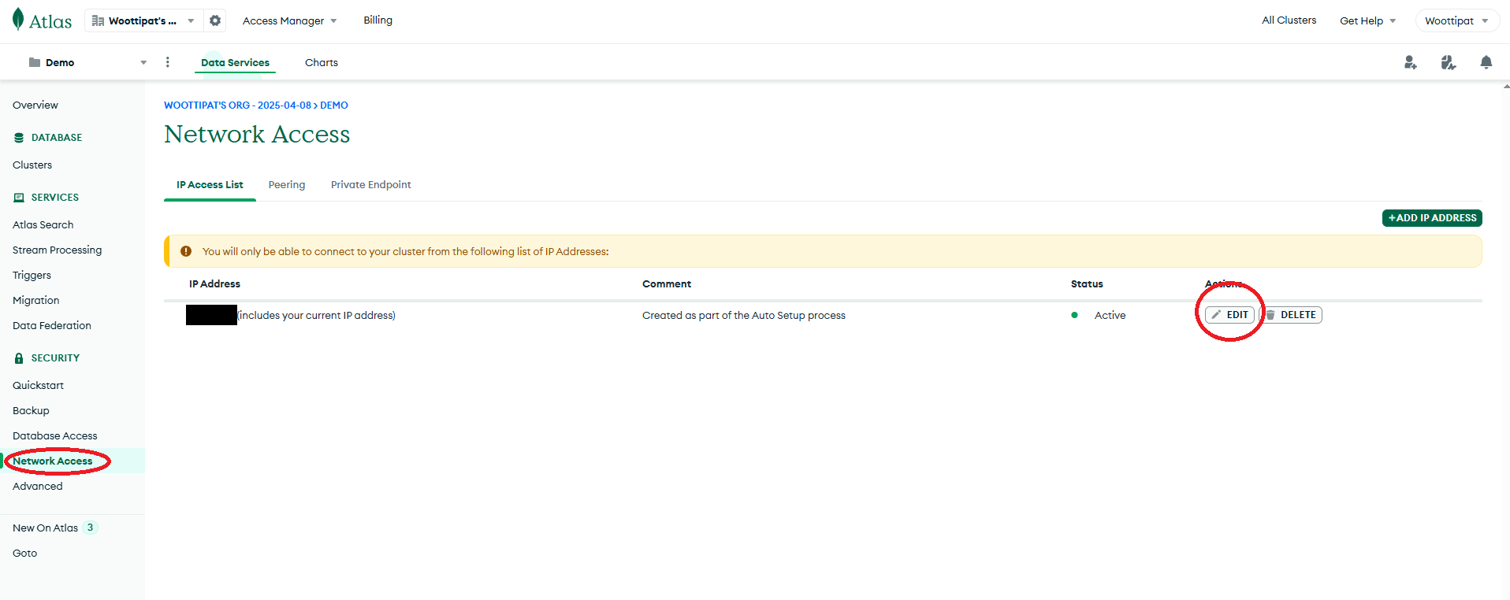

Slide 33
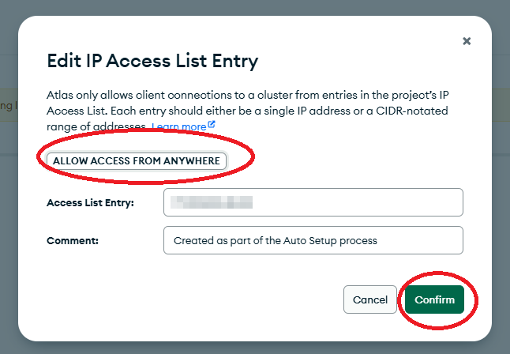

Slide 34
Setting Up VoyageAI

Slide 35
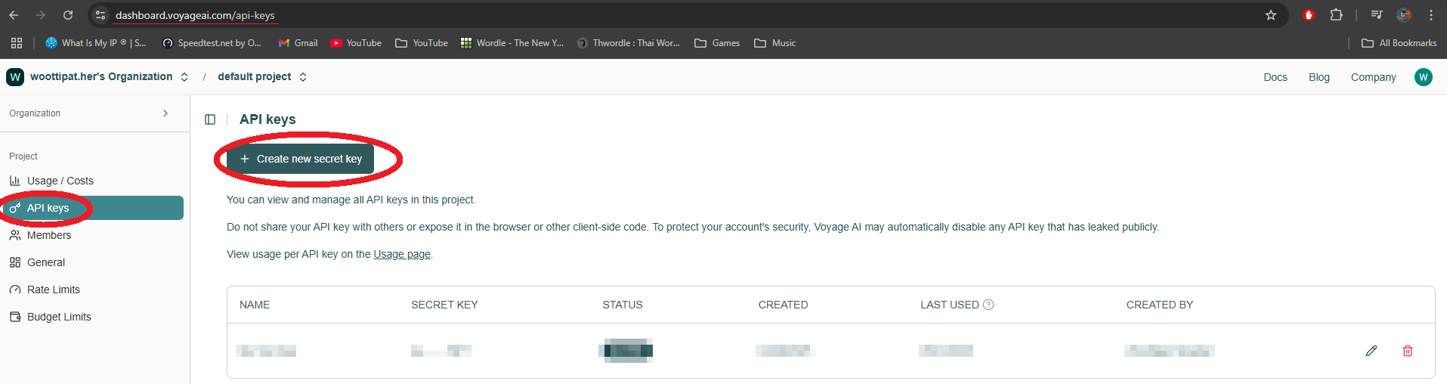

Slide 36
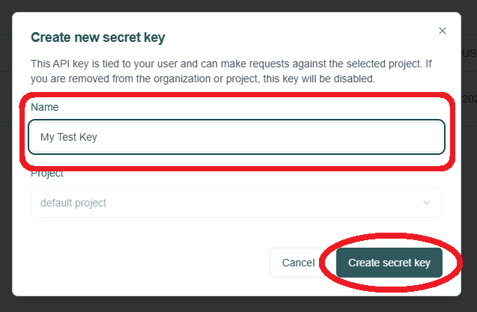

Slide 37
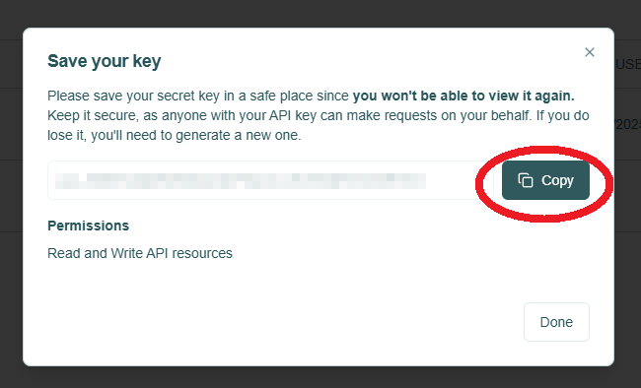

Slide 38
Setting Up OpenAI

Slide 39
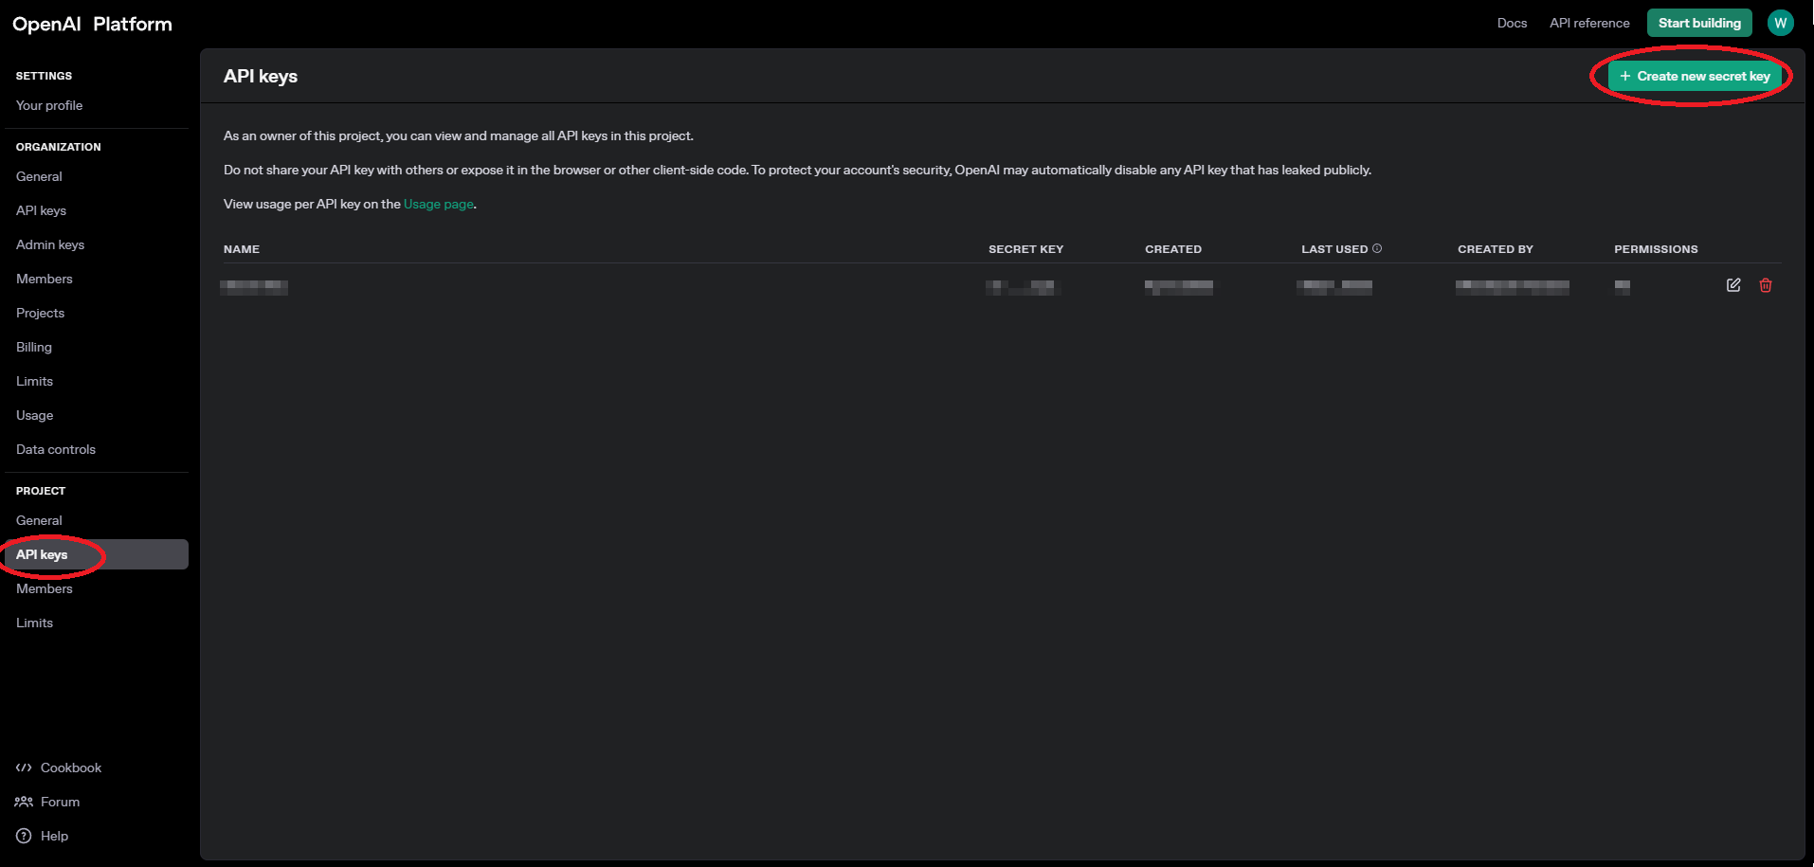

Slide 40
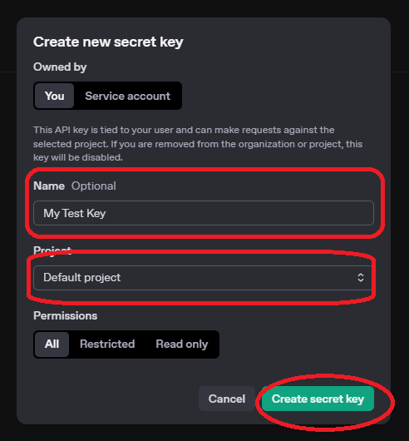

Slide 41
